Slide 1
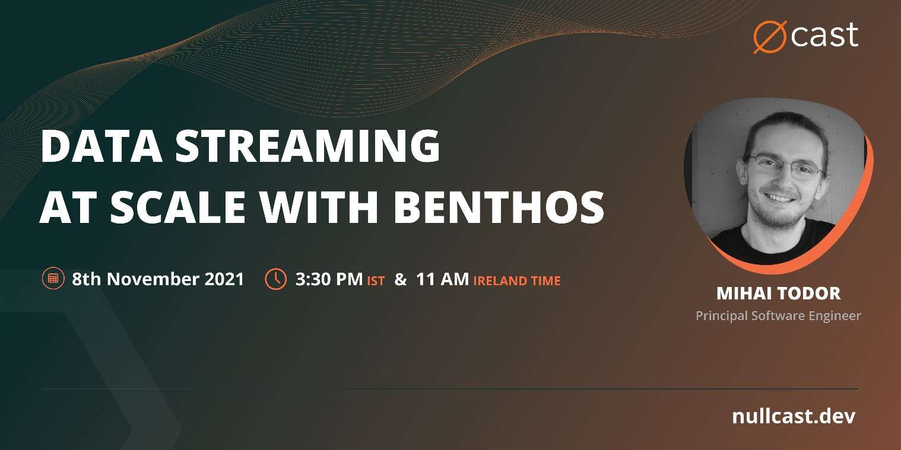
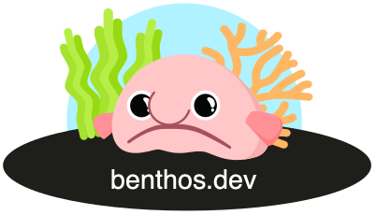

Slide 2

What is Benthos? https://www.benthos.dev/
Hint: It has nothing to do with deep sea fish, except for the logo

Slide 3
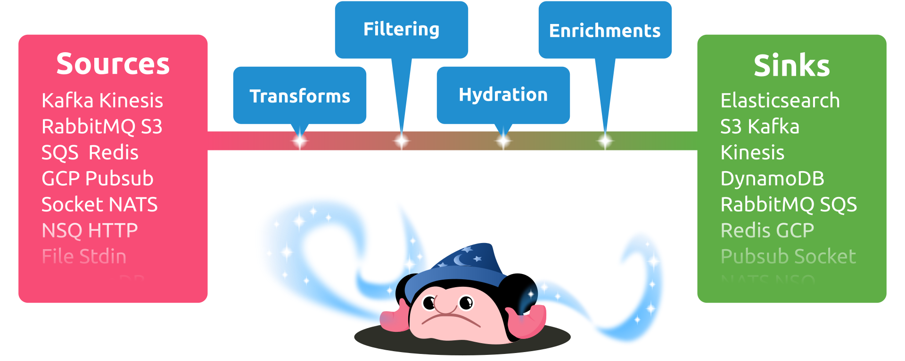
What is Benthos for?
“Fancy stream processing made operationally mundane” - Ash Jeffs

Slide 4

What is Data Streaming?
Go Time Podcast episode #192: https://changelog.com/gotime/192
Realtime ingestion and transformation of (small) data records from one or multiple sources in parallel
Batch processing of large volumes of data records
Event sourcing blurry lines

Slide 5

Data engineering
The Data Stack Show Podcast episode #60: https://datastackshow.com/podcast/architecting-a-boring-stream-processing-tool-with-ashley-jeffs-of-benthos/
Project history
Origins of the awesome logo

Slide 6

Boringly easy to use
# Install
curl -Lsf https://sh.benthos.dev | bash
# Make a config
benthos create nats/protobuf/aws_sqs > ./config.yaml
# Run
benthos -c ./config.yaml

Slide 7

Features
Declarative YAML-based configuration
Single message transforms
Stateless
At least once delivery
Metrics and logging
Custom Plugins
Written in Go

Slide 8

Bloblang
root.new_doc = match {
this.doc.type == "article" => this.doc.article
this.doc.type == "comment" => this.doc.comment
}
Custom DSL for arbitrary data transforms

Slide 9


Deployment models
Standalone CLI app
Serverless
Kubernetes

Slide 10

Importing Benthos as a library
> go get github.com/Jeffail/benthos/v3/public/components/all
package main
import (
"context"
"github.com/Jeffail/benthos/v3/public/service"
// Import all standard Benthos components
_ "github.com/Jeffail/benthos/v3/public/components/all"
)
func main() {
service.RunCLI(context.Background())
}

Slide 11
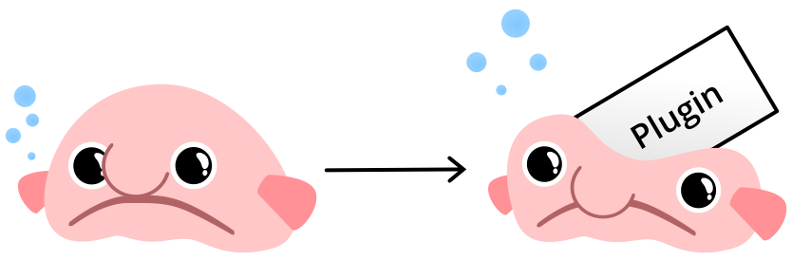
Writing a custom Benthos plugin
type processor struct{}
func (r *processor) Process(ctx context.Context, m *service.Message) (service.MessageBatch, error) {
println("foobar")
return nil, nil
}
func (r *processor) Close(ctx context.Context) error { return nil }
func init() {
_ = service.RegisterProcessor("foobar",
service.NewConfigSpec(),
func(conf *service.ParsedConfig, mgr *service.Resources) (service.Processor, error) {
return &processor{}, nil
},
)
}
// go run main.go create stdin/foobar/stdout > config.yaml
// go run main.go -c config.yaml

Slide 12


Future enhancements
More adapters
Custom plugins
Project S

Slide 13
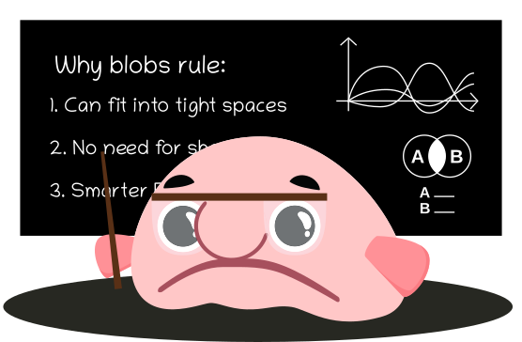
Why Open Source?
Built on the shoulders of giants
Community-driven features, enhancements and bug fixes
High quality standards enforced uniformly
Open issue tracker and permanent change history
Avoids vendor-driven lock-in

Slide 14

Open Source Needs You!

Slide 15



Community https://www.benthos.dev/community
https://discord.gg/6VaWjzP
https://invite.slack.golangbridge.org
#benthos channel

Slide 16

Thank you!
https://www.linkedin.com/in/mtodor/
https://twitter.com/MihaiTodor
https://github.com/mihaitodor

